Slide 1
ISM 6136
Data Mining
Dr. Tim Smith

Slide 2
Model Evaluation:
Custom F Score

Slide 3
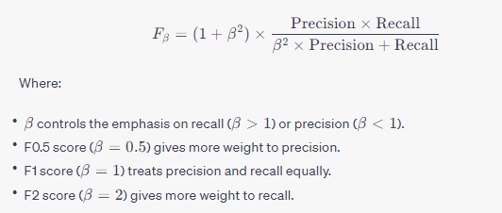
Custom F-Score

Slide 4
Unsupervised Learning

Slide 5
What is Unsupervised Learning?
Unsupervised Learning is a type of machine learning algorithm that works with unlabeled data. The system tries to learn the patterns and the structure from the data without any supervision.
Applications:
Customer Segmentation
Anomaly Detection
Natural Language Processing
Image Recognition

Slide 6
Comparison with Supervised Learning
Data:
Unsupervised learning uses unlabeled data, while supervised learning uses labeled data.
Goal:
The goal of unsupervised learning is to find the underlying structure in the data, whereas in supervised learning, it is to make predictions.
Complexity:
Unsupervised learning can often be more complex and computationally intensive as it must make sense of the data on its own.

Slide 7
Clustering

Slide 8
Clustering:
Clustering is a technique in unsupervised learning where the algorithm groups similar data points together based on certain features.
Types of Clustering Algorithms
K-means Clustering
Hierarchical Clustering
DBSCAN (Density-Based Spatial Clustering of Applications with Noise)

Slide 9
K-means Clustering
Algorithm Explanation
K-means clustering is an iterative algorithm that divides a group of n data points into k non-overlapping subgroups. Each data point belongs to the group that has the closest mean value.
Steps:
Initialize k cluster centers randomly.
Assign each data point to the nearest cluster center.
Recalculate the new cluster centers as the mean of the points in each cluster.
Repeat steps 2 and 3 until convergence.

Slide 10
Hierarchical Clustering
Algorithm Explanation
Hierarchical clustering builds a tree of clusters. It starts with each data point as a single cluster and then merges the closest pairs of clusters until only one cluster remains.
Steps:
Start with each data point as a single cluster.
Merge the two closest points into a cluster.
Update the distance matrix.
Repeat steps 2 and 3 until only a single cluster remains.

Slide 11
DBSCAN Clustering
Algorithm Explanation
DBSCAN is a density-based clustering algorithm that groups together closely packed points based on their density. Unlike K-means, it doesn't require the number of clusters to be specified in advance and can find arbitrarily shaped clusters.
Steps:
Start with an arbitrary point that is not part of any cluster.
Expand the cluster by adding all points that are within a specified distance Eps from the starting point.
Continue expanding the cluster by adding points that are within Eps distance from any point in the cluster, and that have a sufficient number of points (MinPts) within Eps distance.
Once the cluster is fully expanded (i.e., no more points within Eps distance), a new unvisited point is retrieved and processed, leading to the discovery of a further cluster or noise.

Slide 12
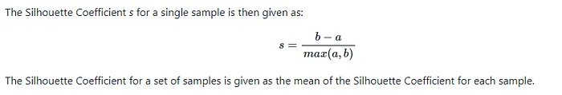
Evaluation Metrics
The Silhouette Coefficient is defined for each sample and is composed of two scores and a higher Silhouette Coefficient score relates to a model with better-defined clusters.
a: The mean distance between a sample and all other points in the same class. This score measures the closeness of points in the same cluster.
b: The mean distance between a sample and all other points in the next nearest cluster. This score measures the distance of points of different clusters.

Slide 13
Happy Learning!

